Slide 1

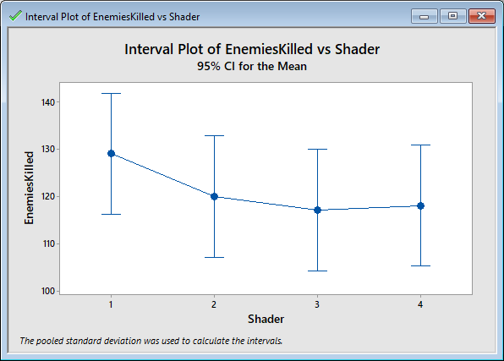
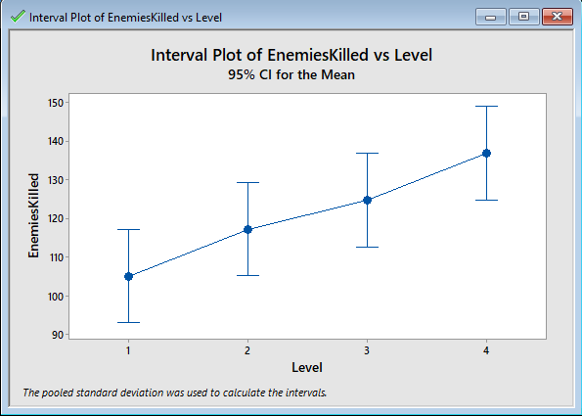
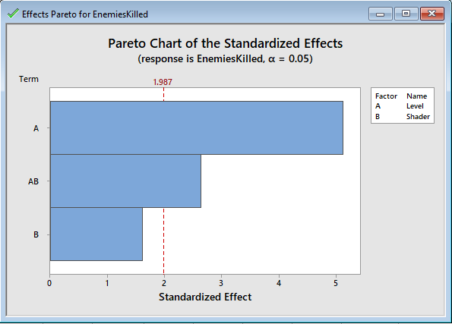
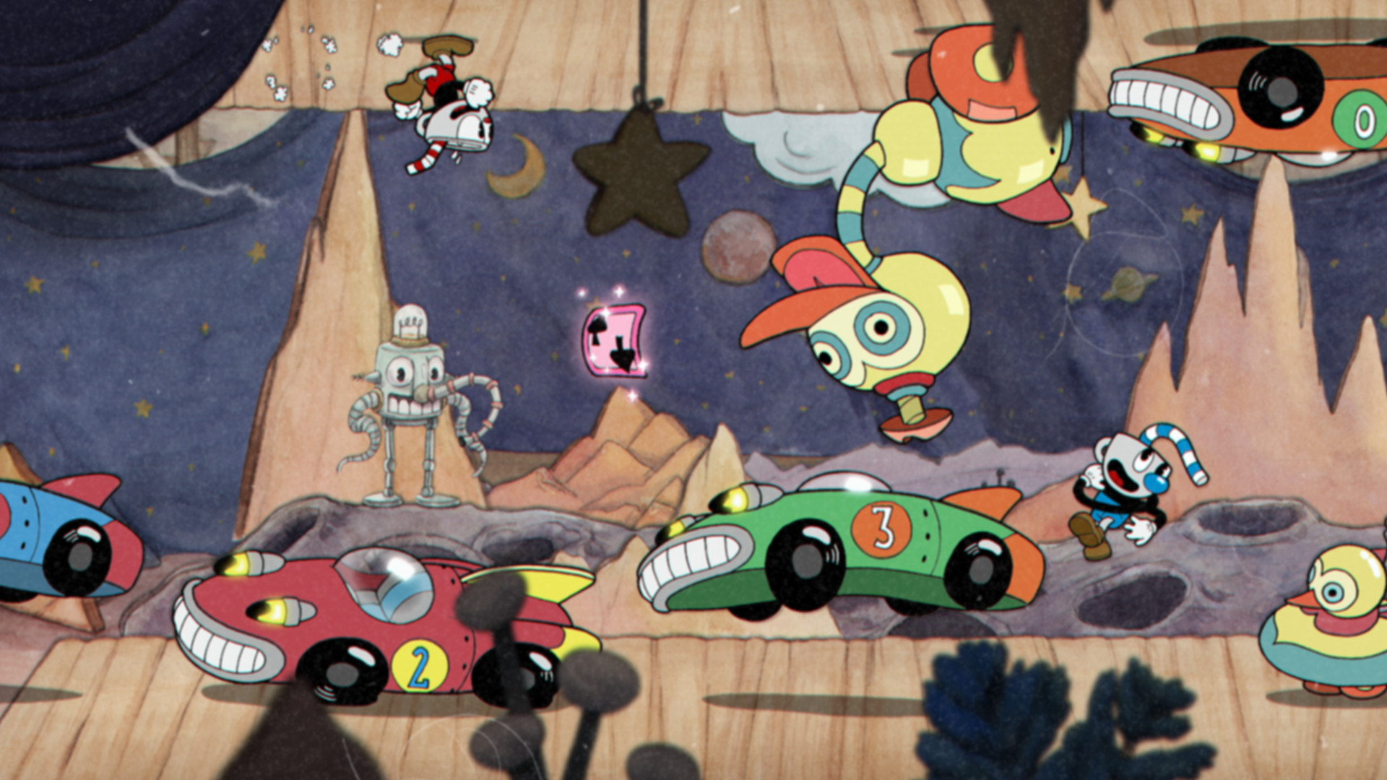
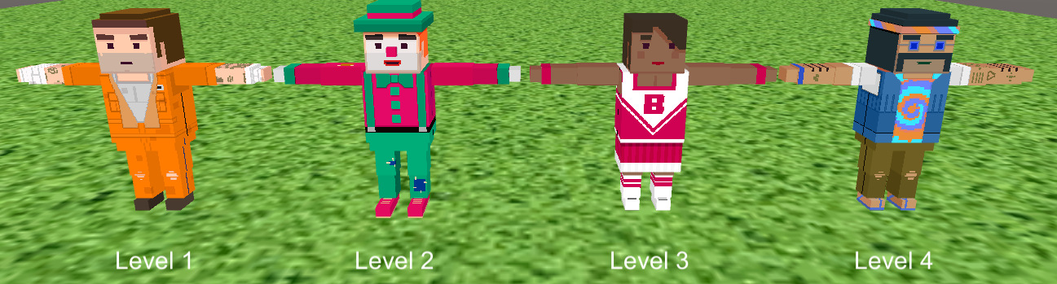
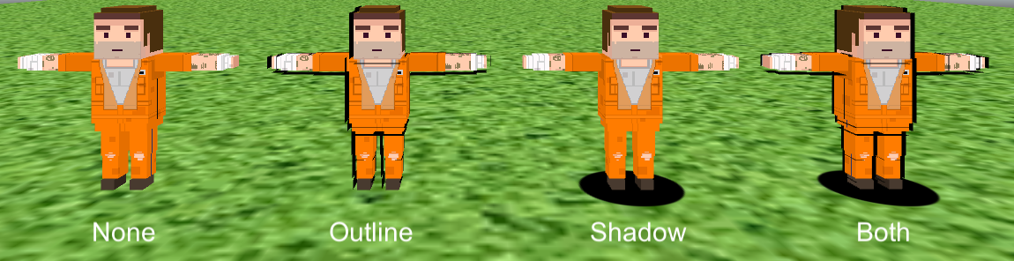
2D Animation Using 3D Tools Travis Samford
and Dr. Michael Findler (Findler@UHCL.edu) Software Engineering, University of Houston – Clear Lake
Abstract
Expressiveness is a major part of hand-drawn animation. The techniques used by traditional animators allow for artists’ intentions to be fully expressed, which is fundamental for stylized animation. The game industry largely focuses on photorealistic rendering techniques for modern game development. Creating better tools and techniques that allow studios to mimic traditional animation will allow for more expressive work. This paper will be covering some techniques that allow for an artists’ intentions to be accurately represented when creating game assets using Unity3D. The techniques covered include creating dynamic character outlines and shadows.
Introduction
Methods
Results
1. Motivation
The animated cartoons of the 1930s were highly stylized works that allowed for an artists’ intentions to be fully realized. The way these cartoons are drawn and how they are animated is a major factor in creating this stylized appearance. This style is very expressive but also labor intensive. If there were tools to get the same effect using 3D models, more studios may pursue this style for their projects
The game industry has become obsessed with photorealism. Very few games try to replicate an expressive 2D style and focus mainly on accurately representing the real world. As a medium, games are creatively limitless and it is a waste to not explore more imaginative, less realistic worlds and styles.
Giving artists more control over animations and design decisions will allow them to make models with more character.
Implementation
For the study, a game was created in Unity 5.6.1f. 4 levels were made, each having a different combination of the created effects. Technologies used: Unity 5.6.1f, Simple Citizens asset pack, C#, and input is handled by a mouse and keyboard.
The Levels:
Each level has 750 enemies and 250 friendly characters. Their positioned around the field and run across the screen in a timed interval.
The objective of each level is to hit as many targets as possible before the time runs out while avoiding the friendly targets.
Each target is worth 10 points, if hit they increase a multiplier by 1.
The multiplier is reset if a target is not hit in 5 seconds or a friendly is hit.
Before each level the subject is told which target they are supposed to hit.
Figure 4: Enemies killed for each shader type.
Figure 5: Enemies killed as levels progress.
Figure 6: The level effect vrs. the shader effect.
1. Shader versus level progression
According to the data the level progression had a much larger effect on the amount of enemies the subjects killed.
It is apparent there is learning going on as the subjects play the game more.
The shader applied appears to have no significant difference.
2. Keeping in mind
This study was unbalanced. There was not a representation of every combination of levels and shaders.
It is possible that if there was a full representation that the shaders would have had as much of an effect as the level progression or more.
Data of 2 subjects was discarded because their was confusion of the objective of the game.
It is possible that the shader made the targets more visible, but they were visible enough that the difference didn’t matter.
Some of the subjects indicated that the outline was hard to see when the game was fully zoomed out. Growing the outline with the camera distance would be an improvement.
Figure 2: Enemy by level.
The Study:
There were three rounds of subjects, each getting a different order of the shader combinations.
Each round had 8 subjects.
Before each level subjects were presented with instructions on the upcoming level.
Once the level started the subjects had 3 minutes to shoot as many targets as possible.
At the end of each round the subjects were given a QUIS survey to fill out.
Once all 4 levels were completed an end of game survey was given.
:
Figure 1: A screen capture from the video game Cuphead
2. Objectives
Develop tools that will empower game designers and developers to use more expressive styles in their work.
Replicate the 1930s style of animation and art. This will be accomplished by applying several non-photorealistic rendering techniques
Generate an outline around the 3D models. To accomplish this, a custom shader is created.
Generate the shadows that follow characters around by dynamically generating them. This will be accomplished by using a Unity projector object with a ramp texture.
These tools should be as efficient as possible to allow their use on both mobile and desktop applications.
References
Blackstein, A. L. (2000). Stylized rendering techniques for scalable real-time 3d animation.
Hughes, L. M. (2000). Art-based Rendering with Continuous Levels of Detail. In In NPAR 2000 : First International Symposium on Non Photorealistic Animation and Rendering (pp. 59--66).
Hughes, M. A. (1999). Art-based rendering of fur, grass, and trees. In Proceedings of SIGGRAPH 99 (pp. 433--438).
Markosian, P. B. (2006). X-toon: An extended toon shader. In In Proceedings of NPAR 2006 (pp. 127--132).
Mitchell, D. C. (2002). Non-Photorealistic Rendering with Pixel and Vertex Shaders. In In Direct3D ShaderX, Wordware (pp. 319--333). Wordware Publishing, Inc.
Wien, S. M. (n.d.). Abstract Cartoon Style Rendering.
Figure 3: All possible effects combinations.

